Slide 1
Smart Kitchen
Harrison Kelly, Brian Day, and Ajay Sarikonda

Slide 2
What is it?
Smart Kitchen solves the problem of remembering what items are in your kitchen by creating a simplistic way to visually see the items in your kitchen from any device with internet access.
The only actions required by the user are:
Scanning a new item when purchased.
Deleting an item when it is used up or thrown away.

Slide 3
Features
Web Interface with an alert system for new events
Camera based scanner and cheap, easy to get hardware (~$60)
Wireless capability
A power saving feature which is disabled by motion or control from the Web Interface
Leverages a large product database
Ability to enter, edit, and delete items
Visual acknowledgments for barcode scanning and system status through LED

Slide 4
Design
The front end user interface of Smart Kitchen was developed using AngularJS and PHP to create a user friendly way of interacting with the items in the kitchen.
The REST API was developed using Python’s Flask module and allows for simultaneous communication between the Raspberry Pi and the front end user interface with token based authentication.
The Scanner software was developed using the RPi python module and interacts with the scanner and motion detector on the Raspberry Pi.

Slide 5
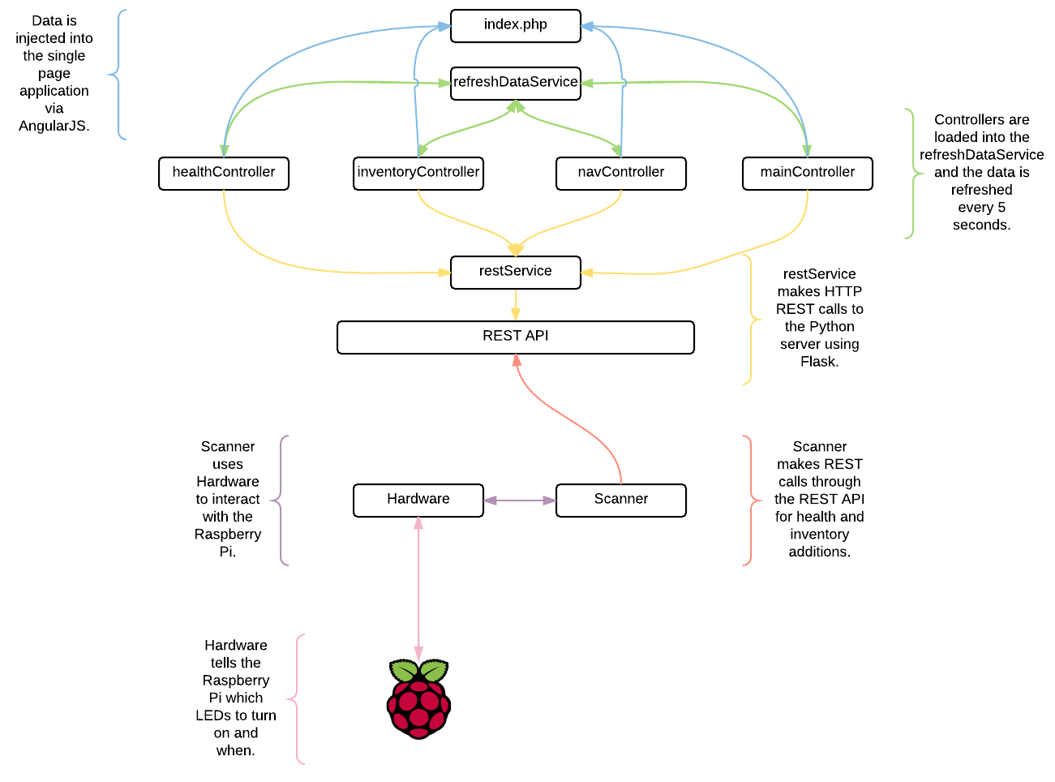

Slide 6
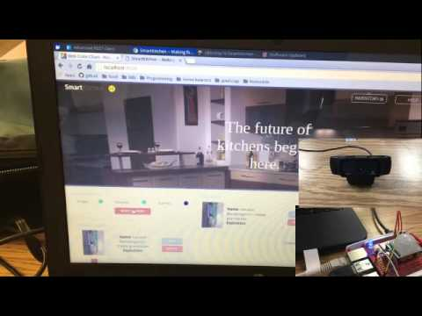
Demo

Slide 7
Questions?

